Slide 1

BLOOD BANK DONATION SYSTEM “LifeLink”
Presented by : Shyam Pratap Vishwakarma
Enrollment No : U2349018
Course : MCA IV Semester
Project Guide : Mr. Anand Durga Singh

Slide 2
CONTENTS
INTRODUCTION
OBJECTIVES
TECHNOLOGY USED
NAME OF ALGORITHM
MODULES
SOFTWARE REQUIREMENT
HARDWARE REQUIREMENT
DATA FLOW DIAGRAM
ER-DIAGRAM
PROJECT OUTPUT
FUTURE SCOPE

Slide 3
INTRODUCTION
The Blood Bank Management System has helped manage blood donations and requests, and has kept records of available blood. It has made sure the right blood type has been given to the right patient and has reduced mistakes.

Slide 4
OBJECTIVES
The current blood bank systems have had some issues like outdated information, which has caused shortages or wrong matches.
They have made human errors where donors and patients haven’t been matched correctly.
Donors have found it hard to access information, and staff have struggled with communication and quick responses.

Slide 5
TECHNOLOGY USED
PHP: Handles server-side processing, manages bookings, and interacts with the database
CSS: Styles the website, ensuring a user-friendly and visually appealing interface.
HTML: Structures the content and layout of the web pages
XAMPP: Provides a local server environment for development, including Apache, MySQL, and PHP.

Slide 6
NAME OF ALGORITHM
Linear Search (Unsorted Data)
Linear search is useful when the data is not sorted or stored in a list format.
Sorting Algorithm
If you need to show the most recent or frequent donors first, use Bubble Sort, Quick Sort, or SQL ORDER BY

Slide 7
MODULES
1. Admin Module
Dashboard
Add Donor
Donor List
Check Contact Us
Update Contact Us
2. User Module
About Us
Why Donate Blood
Become A Donor
Donor Blood
Need Blood
Contact Us

Slide 8
SOFTWARE REQUIREMENT
Operating System : Windows 10
Database : MySQL
Web Browser : Chrome
Programming Languages: HTML, CSS, JavaScript, PHP

Slide 9
HARDWARE REQUIREMENT
Processor : Intel
RAM : 8GB
Speed : 1.80 GHz
System Type : 64-bit

Slide 10
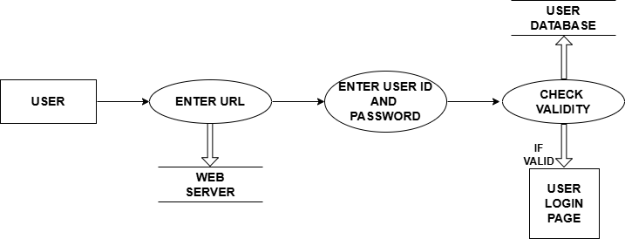
DFD (Dataflow Diagram)
(Zero Level DFD )

Slide 11

DFD (Dataflow Diagram)
(Zero-Level DFD )

Slide 12
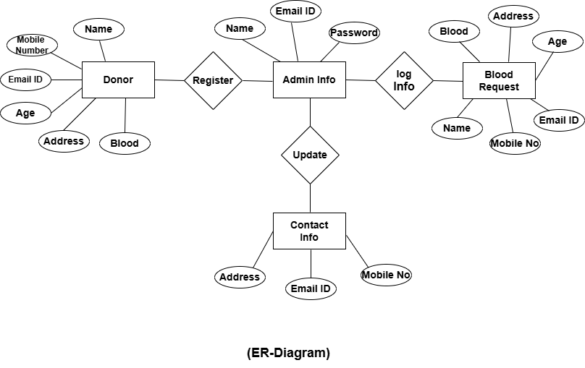
ER-Diagram)

Slide 13
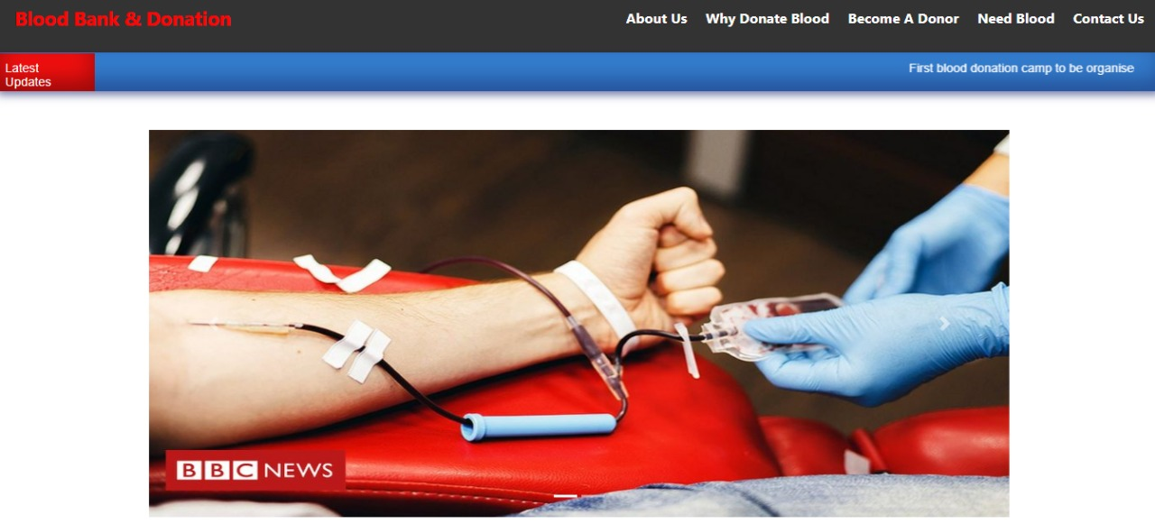
Project output
HOME PAGE:

Slide 14
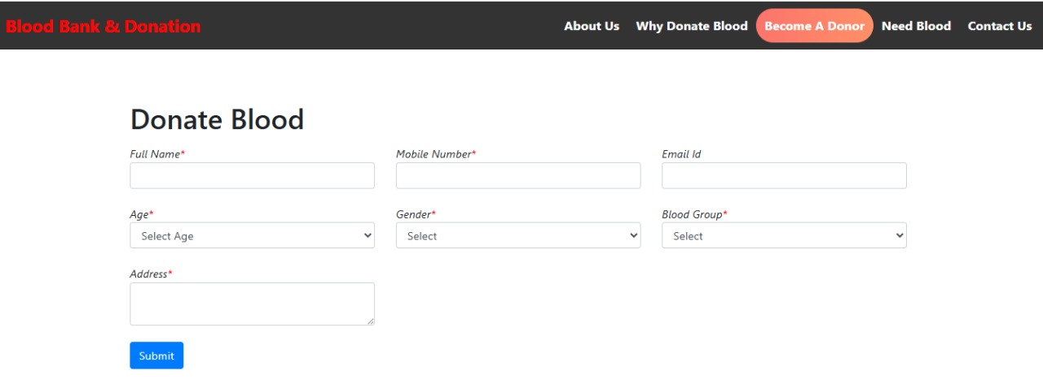
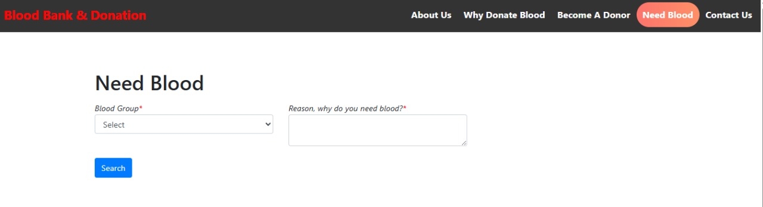
Donor Registration Page:
Search Blood Page:

Slide 15
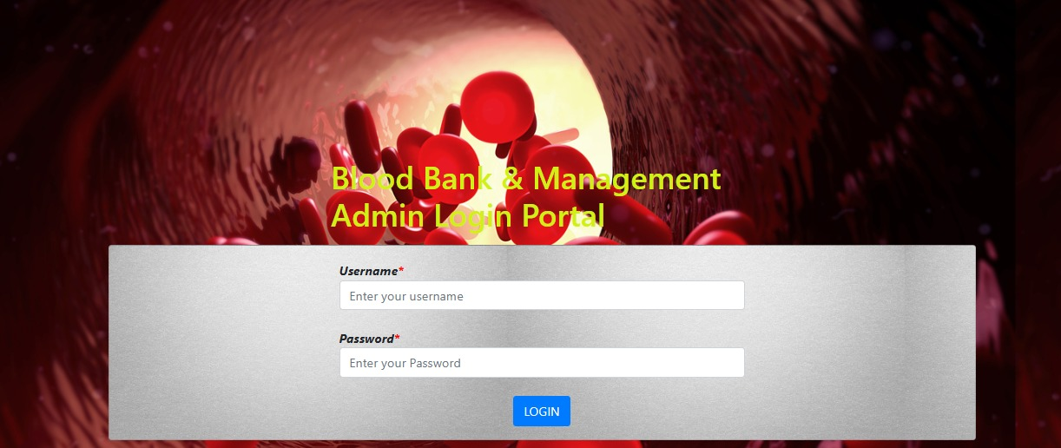
Admin Login Page:

Slide 16
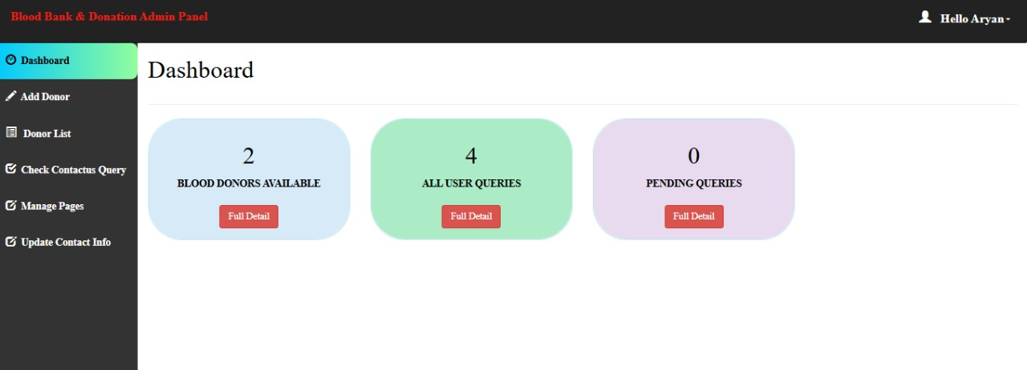
Admin Panel Page:

Slide 17
Future Scopes
Mobile App Development: A mobile version of the Blood Bank Management System can be made, so users can register, donate, or request blood easily from their phones.
Auto Notifications: The system can send automatic SMS or email alerts to donors about upcoming donation dates or blood requests.

Slide 18
THANK YOU VERY MUCH!

